Slide 1

Diabetes Prediction using Logistic Regression
Huong Huynh
Rekha Raj Ravindra
Radhika Sood
Prathiba Swamykannu

Slide 2
Agenda
Summary
Data Preparation
EDA
Variable selection and residual analysis
Model Validation
Model accuracy

Slide 3
Summary
PIMA Indian case study
Dataset
Summary Of Variables - Pregnancies, Glucose, Blood Pressure, Skinthickness, Insulin, Bmi, Diabetespedifreefunction, Age, Outcome

Slide 4
Data Preparation
Missing
Null, duplicate data
Outliers
Incorrect values
Impute data

Slide 5
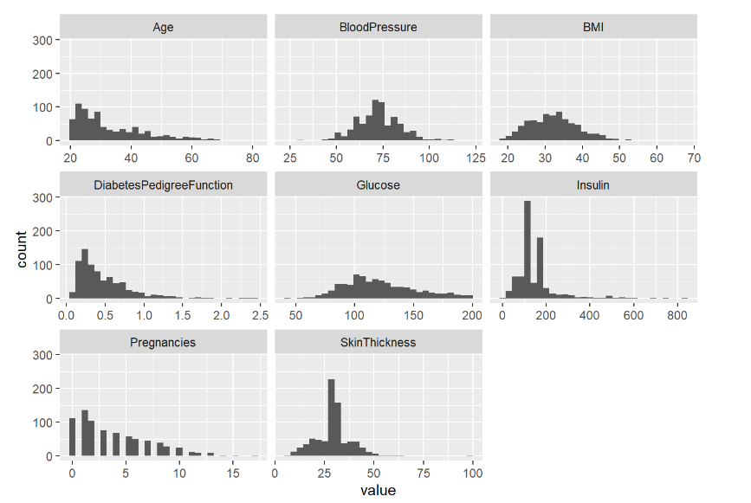
Histogram

Slide 6
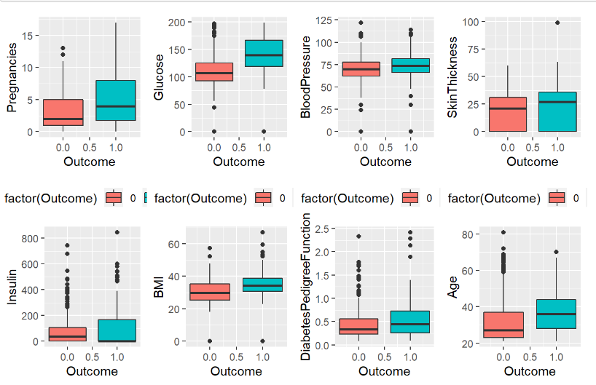
Boxplots

Slide 7
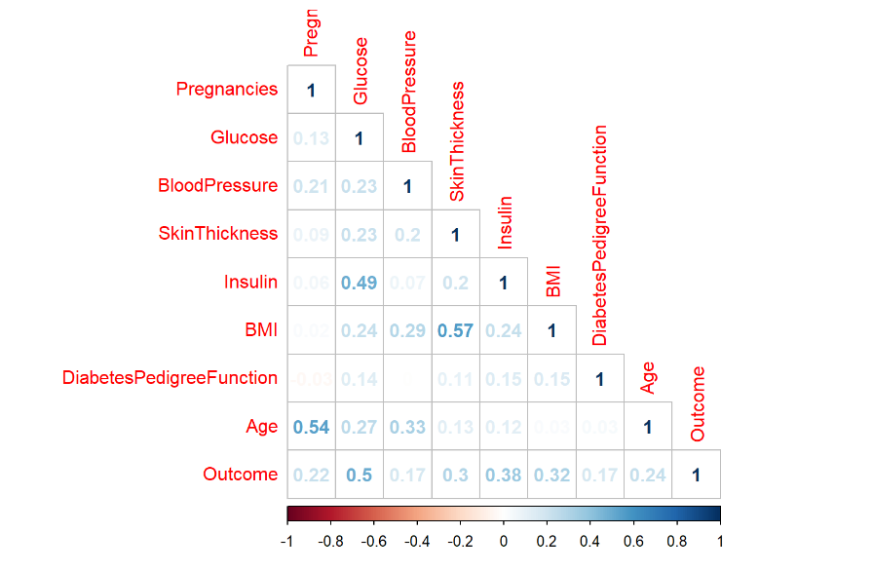
Correlation Matrix

Slide 8
Variable Selection
Variables were selected based on following methods:
P-Value
BIC (Bayesian Information Criterion)
Using Backward and Forward selection

Slide 9
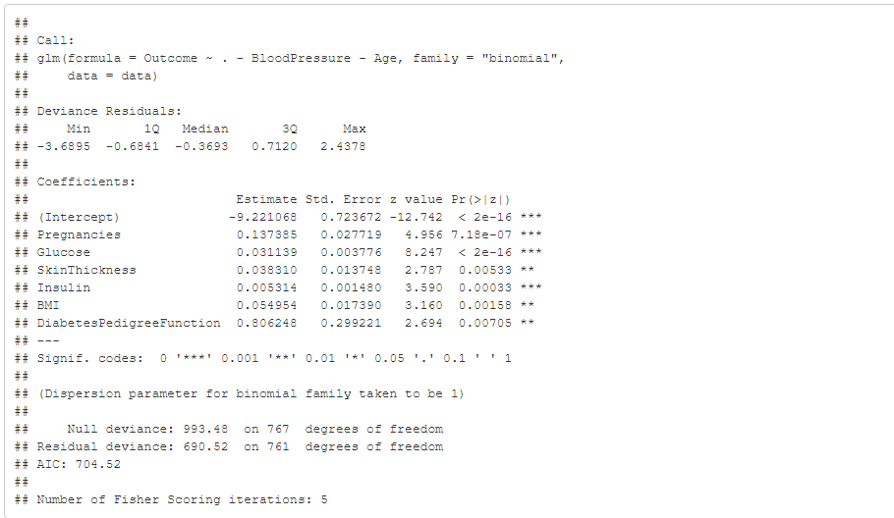
Variable Selection
Model using P-value
AIC: 704.52

Slide 10
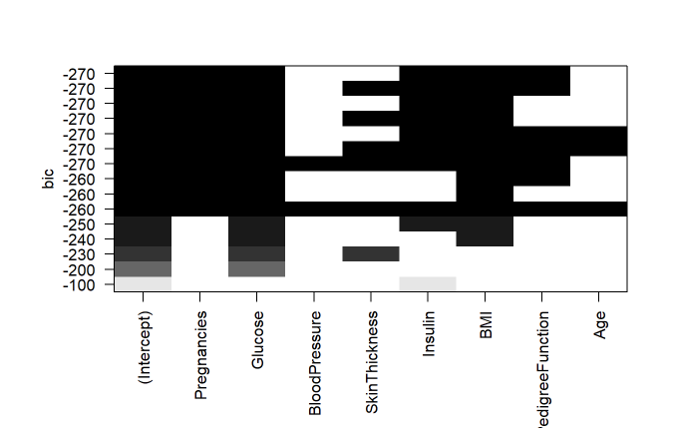
Variable Selection
Model Using BIC
AIC: 710.58

Slide 11
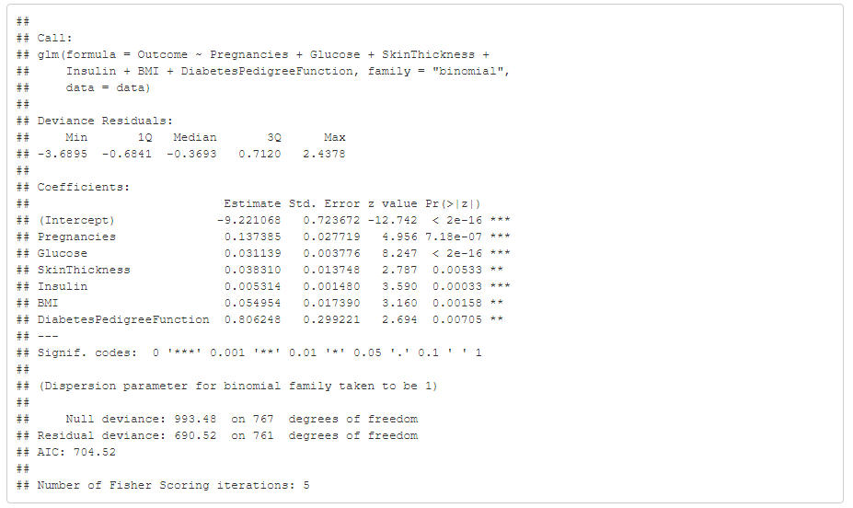
Variable Selection
Using forward and
backward selection
AIC: 704.52

Slide 12
Model
Outcome = -9.22 + 0.13* Pregnancies + 0.03* Glucose + 0.04* SkinThickness + 0.005* Insulin + 0.05* BMI + 0.80* DiabetesPedigreeFunction

Slide 13
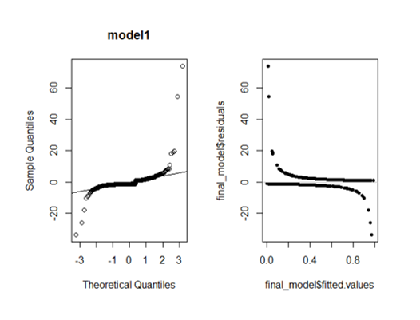
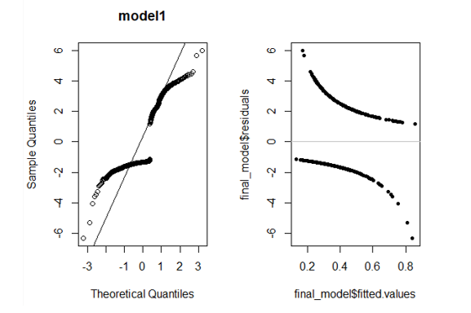
Residual Analysis
Before Transformation
After Transformation

Slide 14
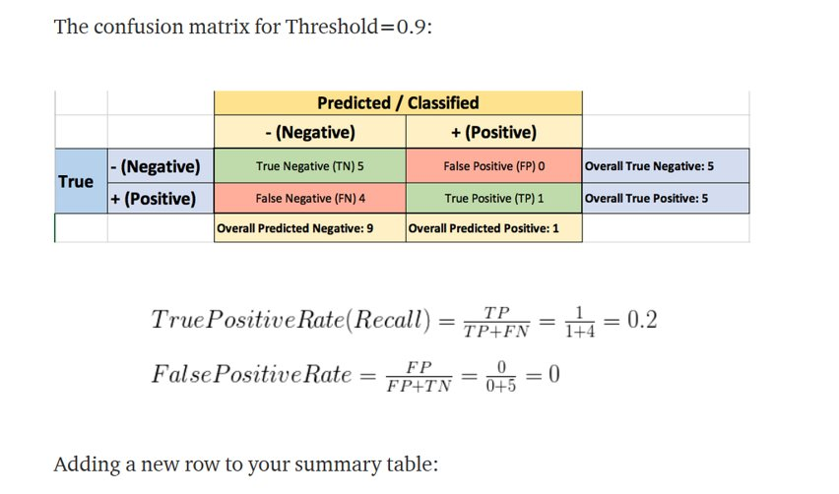
Model Validation

Slide 15
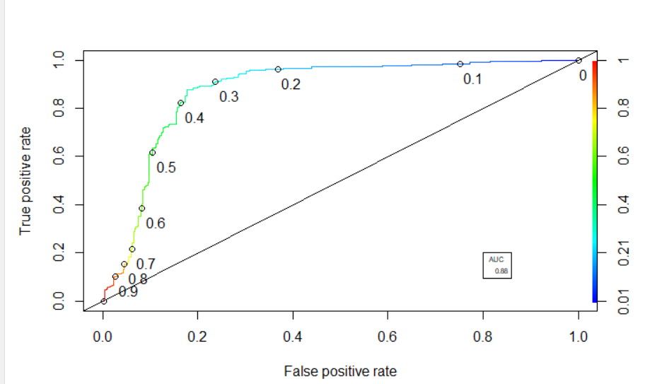
Model Validation

Slide 16
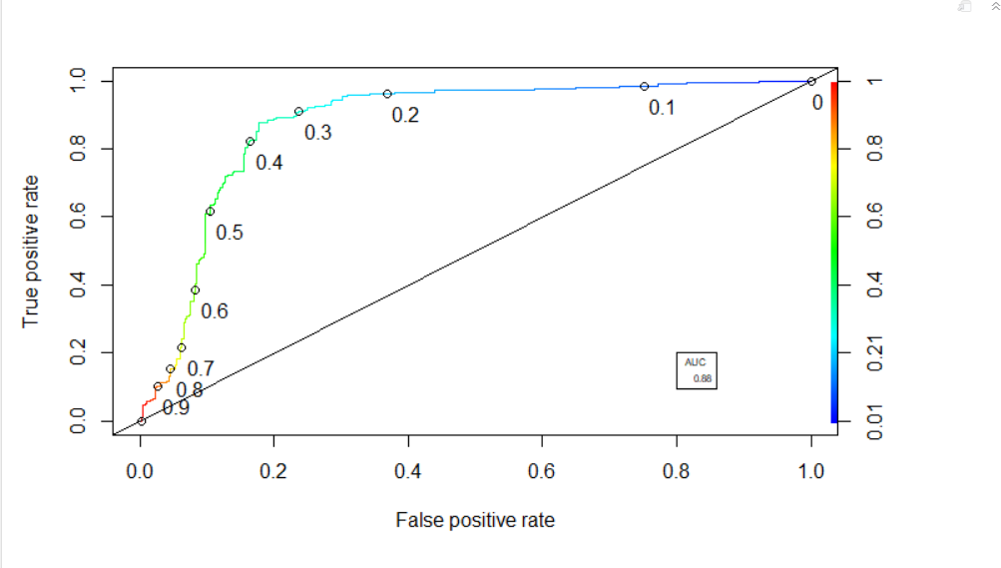
Model Validation

Slide 17
Model Accuracy
The Model has an accuracy of around 88% on both training and testing data.

Slide 18
Any questions?

